Slide 1
Object Detection – YOLO & Faster R-CNN
Week 7 - Day 3

Slide 2
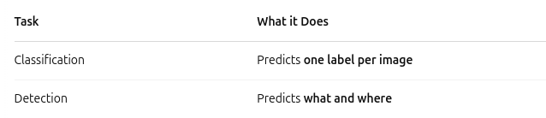
Classification vs Detection
Example:
Classification: "This is a dog"
Detection: "This is a dog at (x, y, w, h)"

Slide 3
Object Detection Pipeline
Input Image → Feature extraction (CNN) → Region proposals (optional) → Bounding box regression + class prediction
Output: Boxes + Class Labels + Confidence Scores

Slide 4
What is YOLO? (You Only Look Once)
Real-time object detection model
Treats detection as a regression problem
Divides image into grid cells
Predicts:
Bounding boxes
Class probabilities
Confidence score
Key Point: All in one forward pass → Super fast!

Slide 5

YOLO – How it Works
Break image into an S × S grid
Each cell predicts:
B boxes (coordinates)
Confidence
C class scores
Example: YOLOv3 = 13x13x(3×5 + 80)

Slide 6
Pros & Cons of YOLO
✅ Pros:
Very fast (real-time detection)
Good general performance
⚠️ Cons:
May struggle with small objects
Less accurate for precise localization

Slide 7
Faster R-CNN – Region Proposal Approach
Two-stage detector:
Region Proposal Network (RPN): Suggests regions likely to contain objects
Classifier & Box Regressor: Refines predictions
Uses backbone CNN (e.g., ResNet) for feature extraction

Slide 8
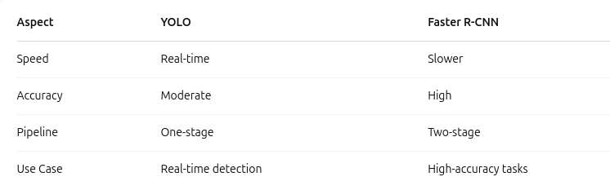
Faster R-CNN vs YOLO

Slide 9
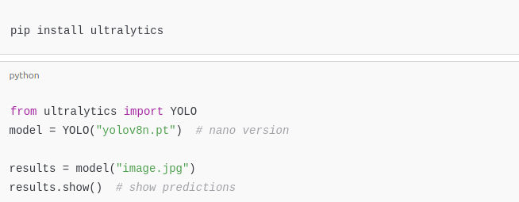
Pretrained YOLO in Action

Slide 10
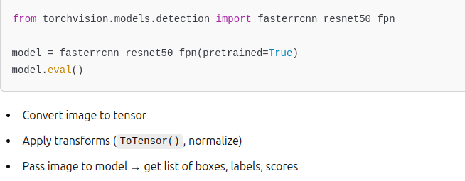
Pretrained Faster R-CNN in PyTorch

Slide 11
Use Cases of Object Detection
Autonomous driving (detect pedestrians, signs)
Surveillance and security
Healthcare (detect tumors, instruments)
Retail (shelf product monitoring)
Robotics and drones

Slide 12
Challenges in Object Detection
🚧 Common Challenges:
Small or overlapping objects
Class imbalance
Multiple objects in frame
Occlusion
Lighting & angle variation
🛠️ Solutions: Data augmentation, anchor tuning, hybrid models

Slide 13
Activity
🧪 Challenge:
Load 3 sample images
Run YOLOv8 on them
Display bounding boxes and class labels

